Slide 1

On-Page Optimization

Slide 2
Search Engine Optimization
On page optimization
On-Page Optimizing can be defined as: “measures that can be taken directly within the website in order to improve its position in the search engine rankings.”
Examples of on page optimization include the actual HTML code, meta tags, keyword placement along with performing certain tasks to create a search-engine friendly site.

Slide 3
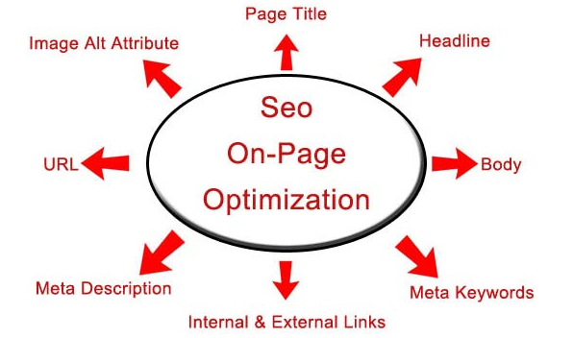
Search Engine Optimization
On page Optimization

Slide 4
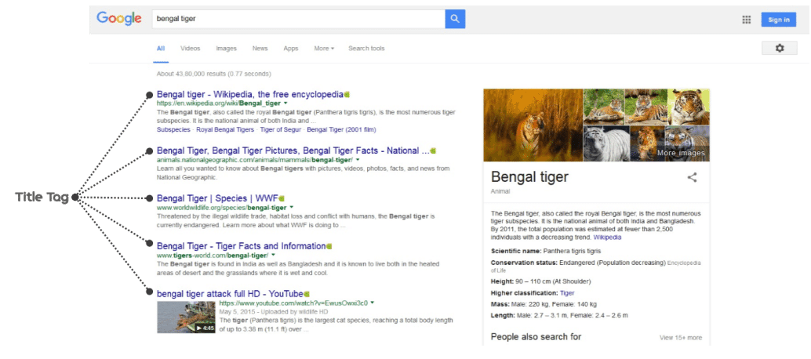
Search Engine Optimization
Title Tag

Slide 5
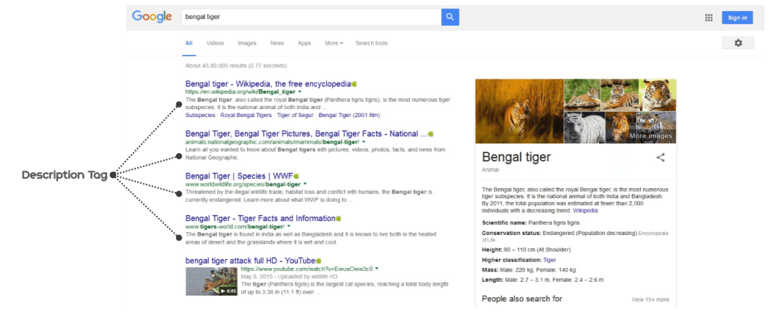
Search Engine Optimization
Description Tag

Slide 6
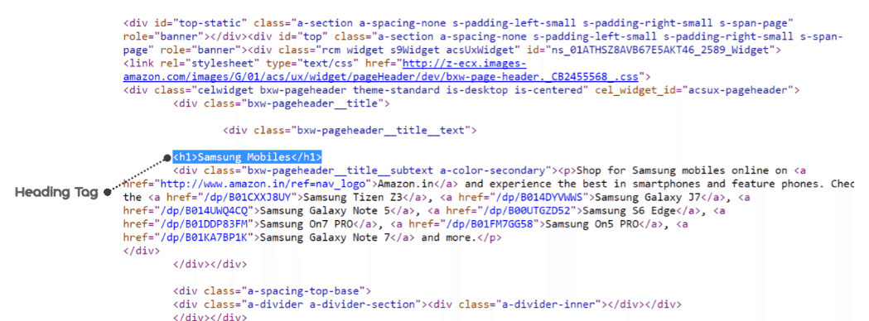
Search Engine Optimization
Heading Tag/H1 tag

Slide 7

Search Engine Optimization
Alternative Text tag/Alt Tag

Slide 8
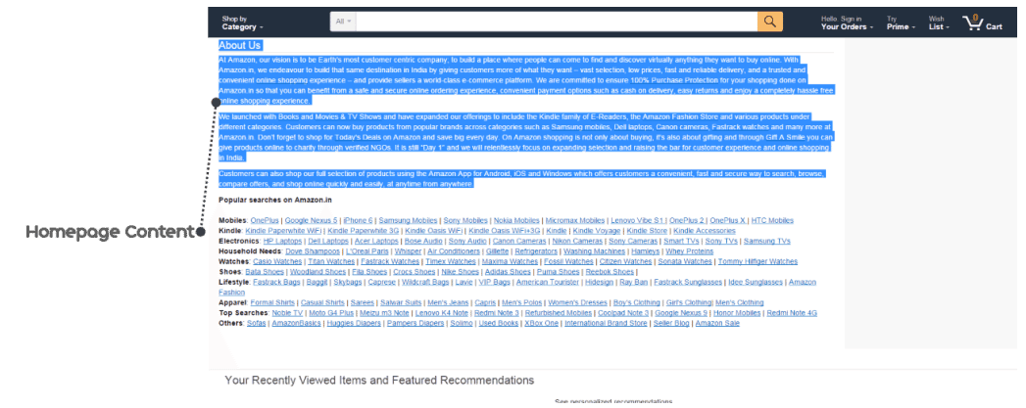
Search Engine Optimization
Homepage Content

Slide 9
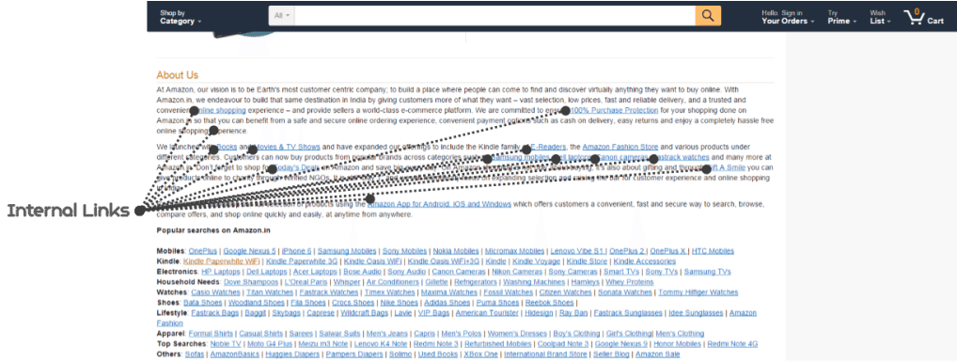
Search Engine Optimization
Internal links

Slide 10
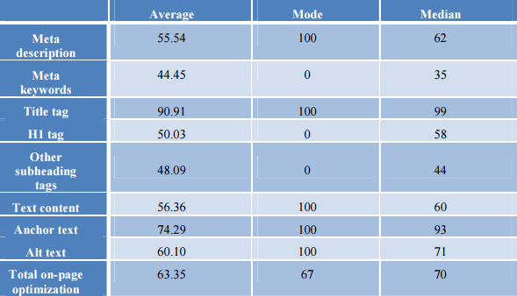
Search Engine Optimization
On page Optimization

